Slide 1

Deepfakes and synthetic media ethics
NAME : JIYA JOYARDAR
STUDENT CODE : BWU/BTA/24/578
COURSE : PROFESSIONAL ETHICS
COURSE CODE : BTA50115

Slide 2
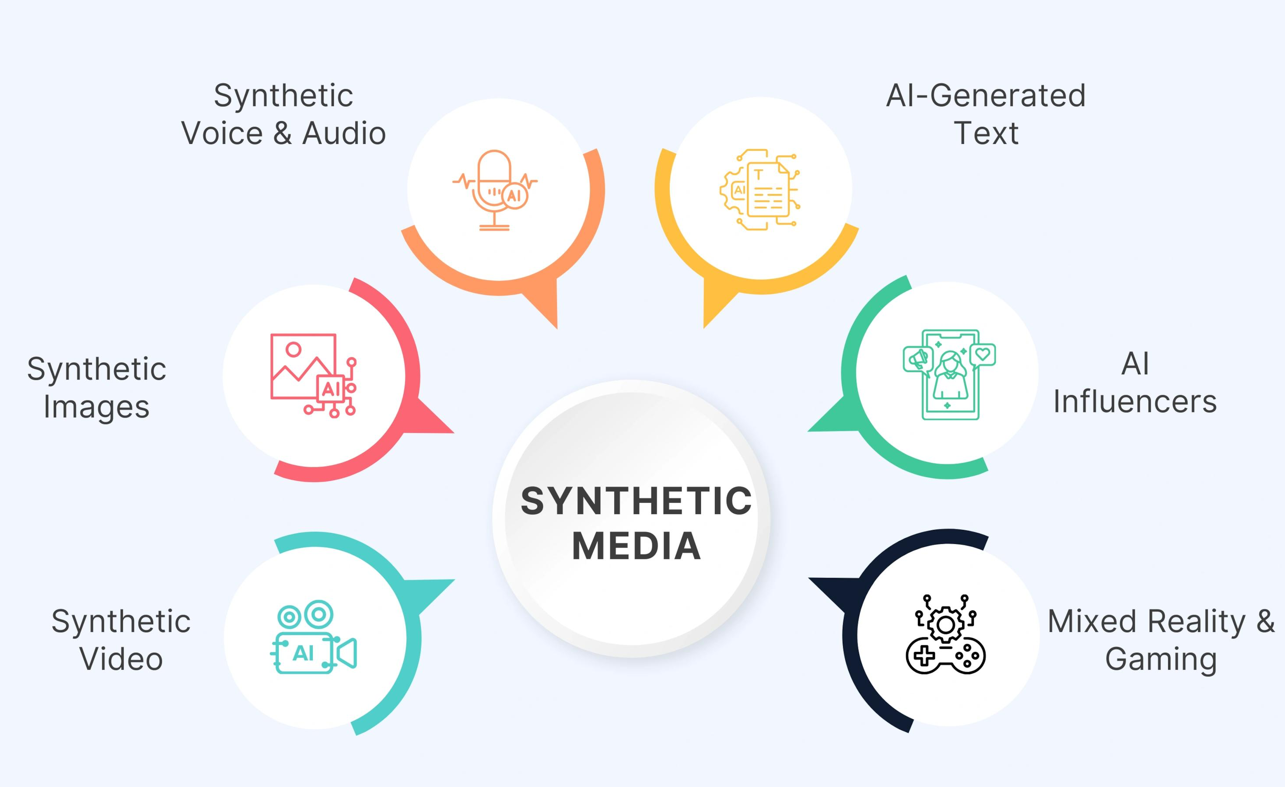
What are deepfakes and synthetic media ?
Deepfakes are AI-generated or manipulated images, videos, or audio that make a person appear to say or do something they never actually did.
Synthetic Media - A broader term for media that is generated or significantly modified using AI.

Slide 3
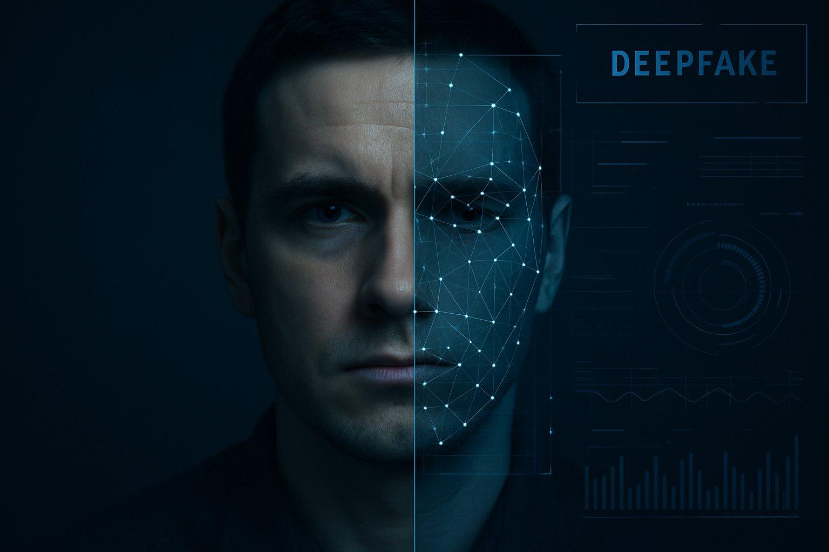
Creation of deepfakes :
Real Data → AI Model → Generation/Manipulation → Synthetic Content
Data Collection :Images, videos, or voice samples are collected.
AI Training :A model learns facial features, expressions, voice patterns, or movements.
Generation :The AI creates or modifies content.
Post-Processing :The output is refined to make it appear more realistic.
Distribution :The content can be shared through social media, websites, or messaging platforms.
Common Techniques: :GANs • Autoencoders • Diffusion Models • Neural Voice Synthesis

Slide 4
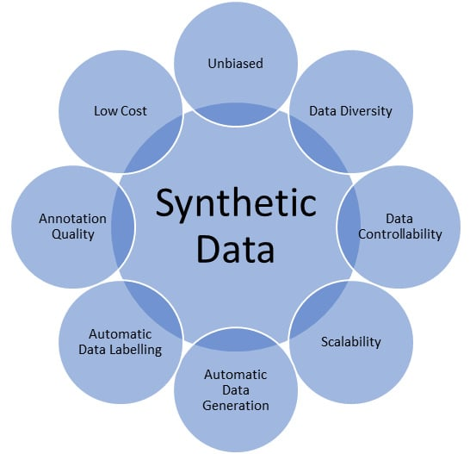
Positive uses of synthetic data :
Entertainment
Film production and visual effects
Dubbing and localization
Digital characters
Education
AI-generated instructors
Historical recreations
Interactive learning experiences
Accessibility
Personalized AI avatars
Voice restoration
Assistive communication
Business & Creativity
Advertising
Virtual influencers
Content creation
Product visualization

Slide 5
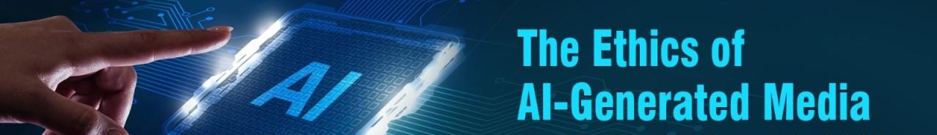
Ethical risks and social impacts :
1. Misinformation
Fake events or statements can be presented as real.
2. Identity & Consent
A person's face or voice may be used without permission.
3. Privacy
Personal images and recordings can be misused.
4. Fraud & Impersonation
Synthetic voices and videos can be used for scams.
5. Reputation Damage
False content can harm individuals or organizations.
6. Loss of Trust
People may begin questioning even authentic media.

Slide 6
What should AI do responsibly:
Consent : Obtain permission before using someone's likeness or voice
Transparency : Clearly disclose AI-generated or manipulated content
Accountability : Someone must be responsible for harmful content
Privacy : Protect personal data used to create synthetic media
Authenticity : Avoid presenting fabricated content as real

Slide 7

Detection, regulation & conclusion
Fighting Deepfake Misuse
AI-based deepfake detection
Reverse image/video search
Audio analysis
Digital watermarking
Content provenance and authenticity systems
Human Responsibility
Verify before sharing
Check the original source
Look for supporting evidence
Be cautious with emotionally provocative content

